Slide 1
Efficiency Works Business
Alaina Hawley
Energy Solutions Engineer
Platte River Power Authority
January 2019
Notes:
Thank you Brett, good afternoon everyone. As Brett said I’m Alaina Hawley and I am an energy solutions engineer at Platte River Power Authority. I work to plan, implement, and evaluate our efficiency programs, specifically the Efficiency Works Business program that I am going to talk about today.

Slide 2
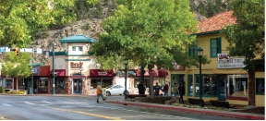
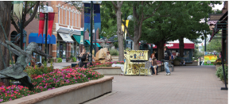
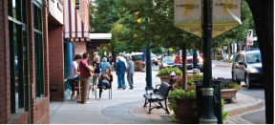
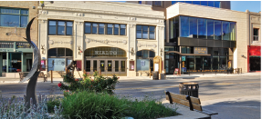
About Platte River
Platte River Power Authority is a not-for-profit wholesale electricity generation and transmission provider that delivers safe, reliable, environmentally responsible, and financially sustainable energy and services to our owner communities of Estes Park, Fort Collins, Longmont and Loveland for delivery to their utility customers.
Notes:
Before we dive into that though, I wanted to give some background for those of you who aren’t familiar with Platte River. We are a not-for profit generation and transmission utility in Northern Colorado. We are owned by and serve four municipalities in the communitires of EP, FC, LM , and LV.

Slide 3
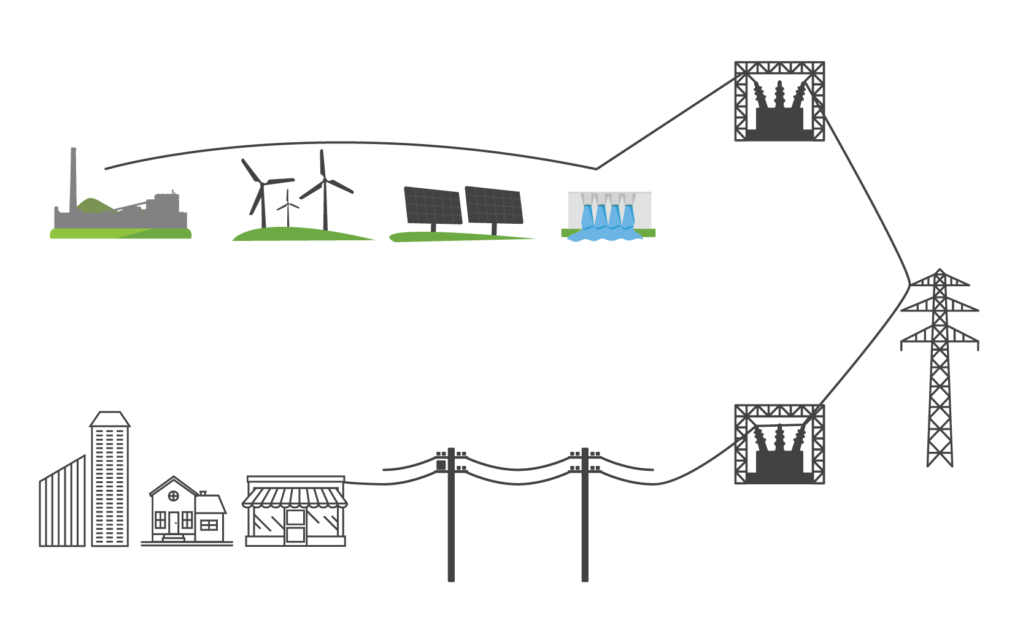
Platte River Power Authority provides electricity to Estes Park, Fort Collins, Longmont, and Loveland
Substation
Generation
Coal and natural gas
Wind
Solar
Hydro
Transmission networks
Distribution lines
Substation
Customers
Platte River’s owner communities distribute power to customers
Notes:
Essentially we own, operate, or manage the purchase power agreements for all of the electricity generated for our four owner communities. We also own and maintain the transmission lines and then sell it to the municipal utilities like Fort Collins Utilities at the distribution level who then sells it to their customers. In addition to the generation and transmission, Platte River also operates the regional energy efficiency programs across the four municipalites.

Slide 4
Efficiency Works introduction
Efficiency Works is a collaboration of common efficiency programs between Platte River Power Authority and the utilities of Estes Park, Fort Collins, Longmont and Loveland.
Notes:
That regional offering is branded Efficiency Works. The consolidation of efficiency programs was done in order to take advantage of economies of scale, provide consistent branding and program rules throughout our service territory and expand offerings to our municipalities with fewer resources than others. Essentially, it allows our customers who own properties in multiple of our communities and our contractors who operate throughout our service territory to only have to learn one program and it’s rules.

Slide 5
Why energy efficiency?
Resource management
Delay generation
Cost management
Customer service
Notes:
Before we get into the details of the program, I want to address a question I get a lot which is “Why would a company that makes money selling electricity want me to use less of it?”. First of all, we are a not-for-profit entity that exists to serve our owner communities and their customers, while working towards our mission of providing safe, reliable, and environmental responsibility and competitively priced energy and services. With that in mind, energy efficiency is viewed as both a resource and a customer service by Platte River. From the resource perspective, EE allows us to delay the need for additional costly generation sources and therefore allows us to manage our costs. From a customer service perspective, Platte River technically only has 4 customers, our owner municipalities, but EE allows us to serve them and their customers more effectively by offering resources and tools for them to be more efficient energy consumers. AS you can see from the graph here, Platte River uses EE when we do our forecasting, and historically EE has reduced our annual energy required to serve, so we continue to plan that reduction into the future.

Slide 6
Efficiency into the future
Notes:
I also get asked frequently, it’s nice that you offer these programs now, but can I expect your programs to be here in the future. While I can’t promise that the programs will look exactly as they do today, Platte River plans to continue to

Slide 7
Efficiency Works
Business
Homes
Higher efficiency & savings
Rebates
Energy advising and facility assessments
Building tune-ups and focused support
Multifamily program
Efficiency Works Store
Rebates
Home energy audits
Lighting and appliance rebates
Refrigerator recycling
Notes:
Bryce

Slide 8
Efficiency Works Business:
2018 program successes
Notes:
Bryce

Slide 9
2018 at a glance
Business
96 Service
providers
participating
Over 29,000
MWhs saved
36,174
LED lamps
installed
1,007 upgrades
Over $7.1M
rebates paid
Over $2.1M
saved annually
Nearly 12% increase over 2017!
Notes:
Bryce

Slide 10
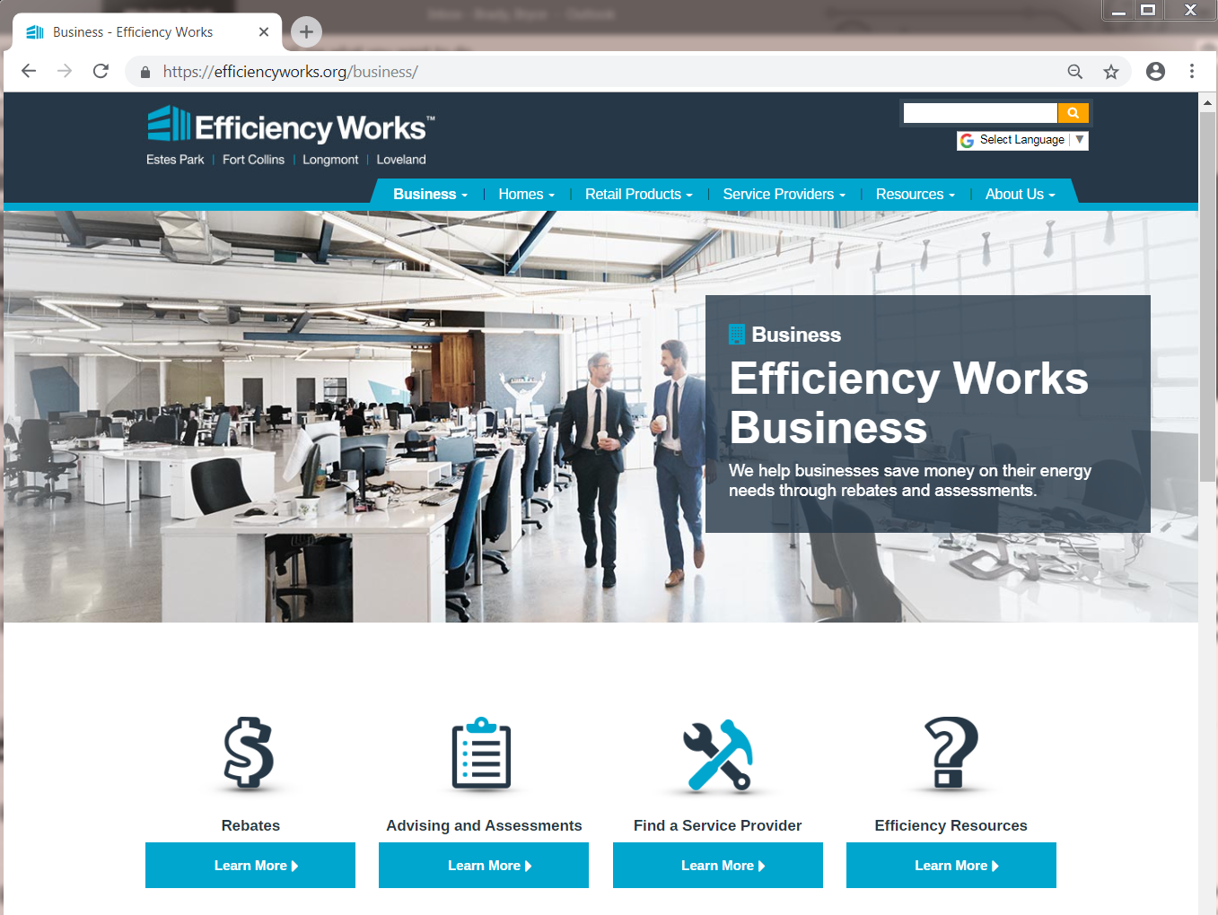
2018 program successes
New website launched
Notes:
Bryce

Slide 11
2018 program successes
Online store
Notes:
Over 100 products available including connected home

Slide 12
2018 program successes
Multifamily program
Direct installs
Facility assessments
Energy advising
Notes:
Started in June 2018, Over 3,000 units DI

Slide 13
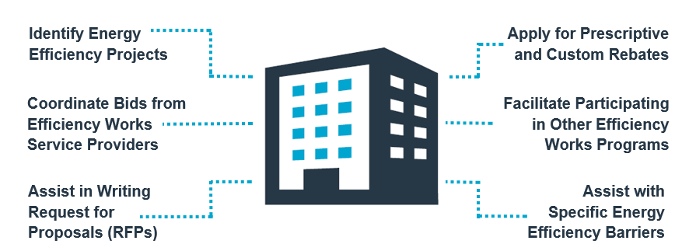
2018 program successes
Energy Management program
Notes:
Bryce

Slide 14
2018 program successes
Other programs
Business programs
Notes:
Bryce
Xx’s to be completed justt before the 29th
Business Rebate Program Since 2014 (includes Platte River and City funds)
Nearly $15M rebates paid since 2014
Over $39.8M invested by local businesses since 2014 through EE upgrades
Over 70,000 MWh/yr have been saved by the customer (equals the energy use of almost 8,300 homes annually)
Over $6.1M annual electric cost savings for the customer
Over 3,200 efficiency upgrades have been completed since 2014 with rebates ranging from $50 to over $200,000.
Business Rebate Program In 2017
Over $6M rebates expected to be paid in 2017
Nearly $17.4M expected to be invested in 2017 by local businesses
Over 26,000 MWh/yr expected to be saved by customers (equals the energy use of almost 3,200 homes annually)
Over $2.0M annual electric cost savings for the customer
Almost 1,000 efficiency upgrades to be completed just in 2017.

Slide 15
Number of business upgrades
Notes:
Bryce

Slide 16
Largest Energy Saver: Single Project
Healthcare facility
Over 1.0M annual kWhs
Interior and exterior lighting
Estimated $78,000 annual electric savings
Notes:
Bryce
Winner to be picked before Nov 29th depending what gets submitted for payment.

Slide 17
Largest Energy Saver: Service Provider
Over 3.5M annual kWhs
418 upgrades completed
Grocery and lighting upgrades
Gaskets, strip curtains, door closers, LED case lighting, interior and exterior lighting
Notes:
Bryce
No ones comes close to OES, Power Down seems to be next but Mike is like 2M kWh less

Slide 18
Most Innovative Project
Ice chiller system
244,796 kWh annual energy savings
$28,426 annual savings
Upgraded to variable speed pumping and VFD chillers from constant speed cooling system
Notes:
Bryce
EW-2018-704

Slide 19
Efficiency Works Business:
2019 program offerings
Notes:
Bryce

Slide 20
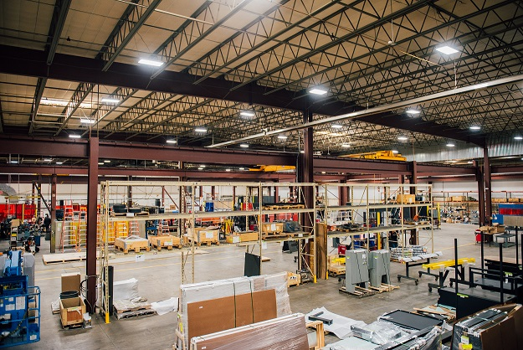
2019 rebates
Lighting – LEDs and controls
Cooling – economizers, controls, evaporative cooling
Envelope – windows, insulation and cool roof
Food Service – cooking and refrigeration equipment, and ice machines
Grocery – refrigeration cases, controls and EC motors
Office & IT – task lighting, ES computers and plug loads controls, thin client, server virtualization
VFDs – up to $120 per HP, 75 HP max (fans, pumps, compressors)
Custom – cooling towers, compressed air, special controls, etc. (Rebates based on $0.10/kWh annual savings or $500/kW)
Notes:
Bryce

Slide 21
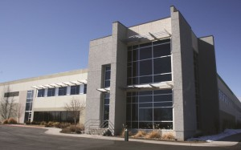
Optimizing existing and new buildings
Building Tune-Up Program
Rebate is based on 100% of the cost of RCx study and implementation support and verification by RSP and customer commits $0.05 per sq ft for implementation of selected measures.
Integrated Design Assistance Program
Performance base incentive for
designing high performance
commercial buildings. Applies to
new construction and major
renovation projects in Fort Collins.
Notes:
Bryce

Slide 22
Facility assessments
Benefits
Provides an efficiency plan
Current utility usage analysis
Benchmarking
Opportunities specific to your facility
Cost and savings information, including rebates
Connects you to our technical resources
Notes:
Bryce

Slide 23
Energy advising
Quality assurance for the customer, contractor and program
Connects you to our technical resources
Notes:
Bryce

Slide 24
Program and project support
Efficiency Works team member available during normal business hours via phone or email
Available to help review bids, applications, and products
Strive for 1-2 business day turn around on emails and less on phone calls
Small team, so we can get to know people and their projects
Notes:
Bryce

Slide 25
Efficiency Works Business:
2019 rebates
Notes:
Bryce

Slide 26
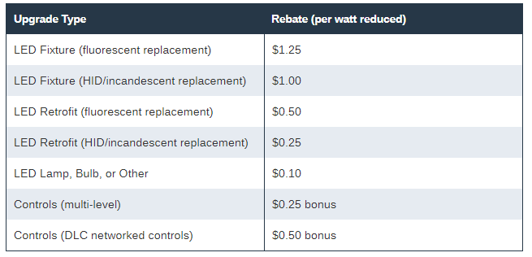
2019 rebates
Lighting:
Notes:
Bryce

Slide 27
2019 rebates
Lighting: new LED fixtures
Upgrade type | Rebate amount $/watt reduced | New rebate amount with 25% bonus rebate
LED fixture (fluorescent replacement) | $1.25 | $1.56
LED fixture (HID or incandescent replacement) | $1.00 | $1.25
* Products are required to be listed as ENERGY STAR or Design Lights Consortium (DLC) qualified.
LED new fixture 25% bonus
Projects pre-approved after December 1, 2018
Completed and submitted for payment by November 15, 2019
Notes:
Bryce

Slide 28
2019 rebates
Lighting: controls
Upgrade type | Rebate amount $/watt reduced (bonus rebate) | Requirement
DLC Networked Controls | $0.50 | Must be on DLC list
Multi-Level Controls | $0.25 | Must be a combination of 2 or more control features
* Products are required to be listed as ENERGY STAR or Design Lights Consortium (DLC) qualified.
Notes:
Bryce

Slide 29
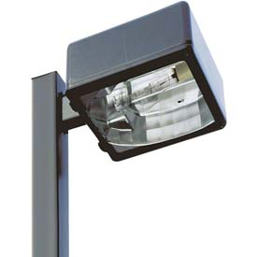
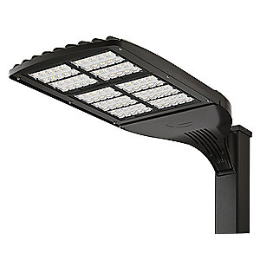
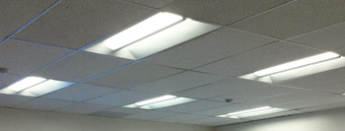
2019 rebates lighting (retrofit examples)
HID to LED example
25% new LED fixture bonus only available while funds last.
$358 per fixture
$447 per fixture
400w
Metal Halide
100w LED
400w
Metal halide
100w LED
With 25% new fixture bonus
Fluorescent to LED example
$99 per fixture
Add DLC Networked Controls
4-Lamp T8’s (114w)
LED troffer (35w)
$124 per fixture
$172 per fixture
With 25% new fixture bonus
Notes:
Bryce

Slide 30
2019 rebates
Lighting (New & Major Reno)
Custom rebate: $0.10 per kWh saved annually
Must beat code requirements by minimum of 10%. ASHRAE Building Area Method (based on space use type LPD)
Watts per square foot
When does it apply?
Interior only
Notes:
Bryce

Slide 31
2019 rebates
Cooling:
Notes:
Bryce

Slide 32
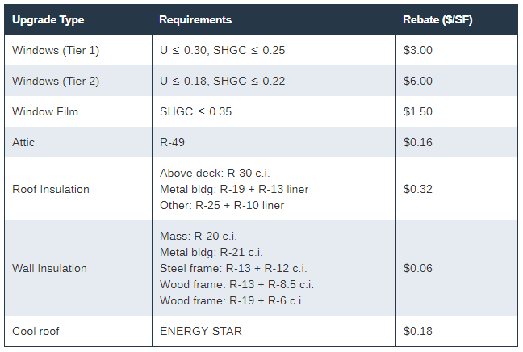
2019 rebates
Building envelop:
Notes:
Bryce

Slide 33
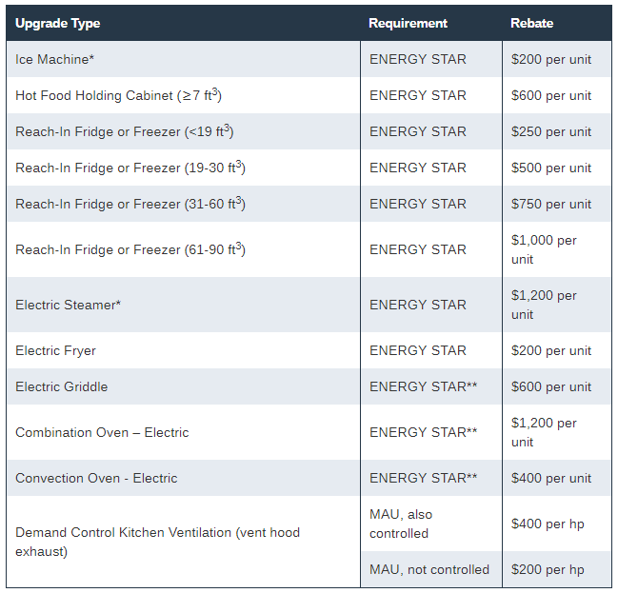
2019 rebates
Food service equipment:
Notes:
Bryce

Slide 34
2019 rebates
Grocery:
Equipment Type |  | Rebate | Rebate
Door auto-closer | Freezer/Cooler | $50 per door | $50/door
Door gaskets | Freezer/Cooler | $7/$6 | $7/$6
Strip curtains | Freezer/Cooler | $75/$150 per door | $75/$150/door
Suction line insulation |  | $1.50 per lineal ft | $50
Zero energy glass door |  | $125 per door | $250
Low energy glass door |  | $75 per door | $125
Anti-sweat heater (ASH) controls |  | $100 per door | $100
EC evaporator fan motor | Reach-in/Walk-in | $50/$100 | $750
PMSM evaporator fan motor Q-Sync | Reach-in/Walk-in | $100/$250 | $300-$2,000
EC compressor head cooling fan motor |  | $50 per motor | $250-$2,000
Night covers (vertical or horizontal) |  | $20 per ln ft case
Smart defrost control for walk-in freezer |  | $400 per controller
Evaporator fan controls walk-in cooler/freezer |  | $50 per fan motor
Outside air economizers for walk-in cooler/freezer |  | $1,250 per unit
.
Notes:
Bryce

Slide 35
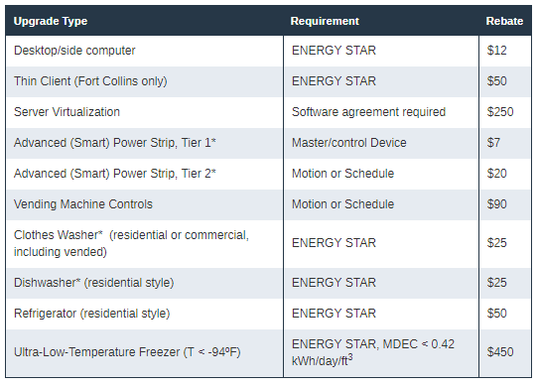
2019 rebates
Office equipment and appliances:
Notes:
Bryce

Slide 36
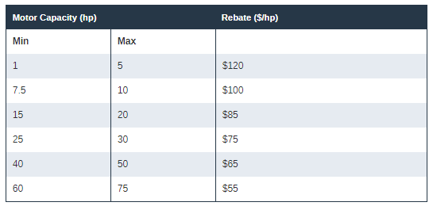
2019 rebates
Variable Frequency Drives (VFDs):
Notes:
Bryce

Slide 37
2019 rebates
Custom:
Notes:
Bryce

Slide 38
Efficiency Works Business:
How to apply for rebates
Notes:
Bryce

Slide 39
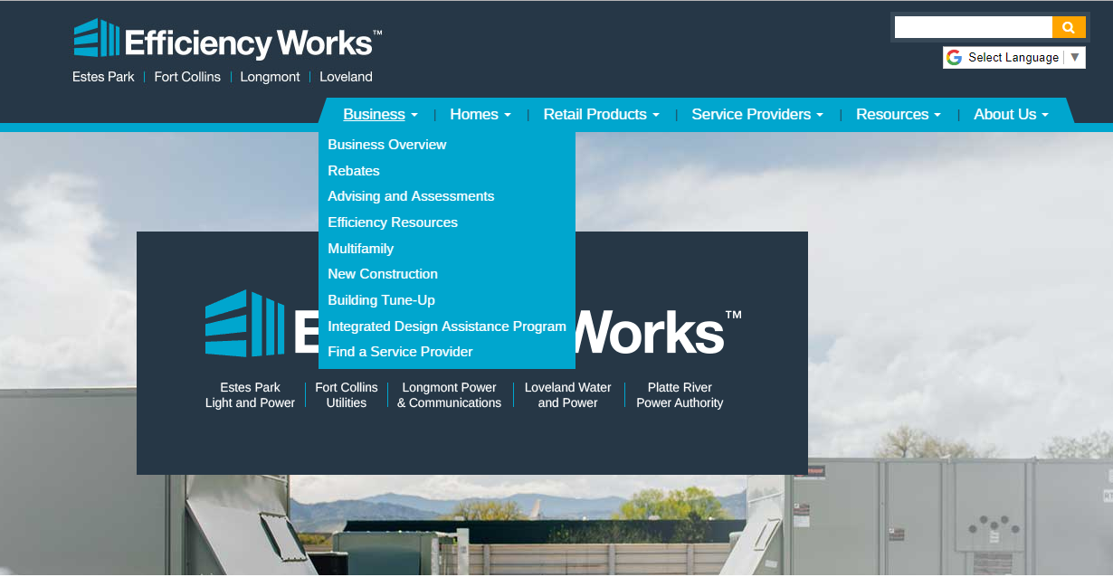
Start at the Efficiency Works website
Notes:
Bryce

Slide 40
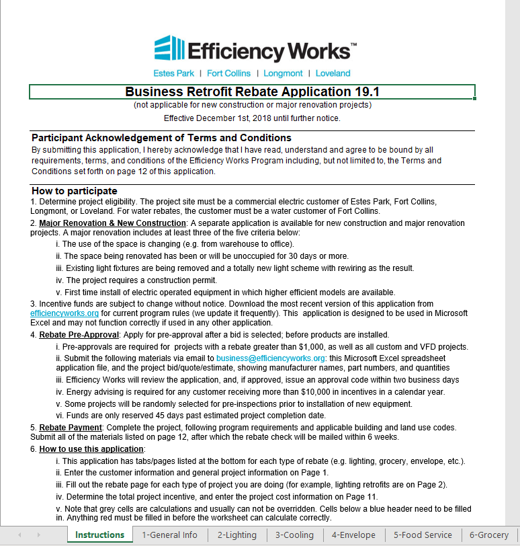
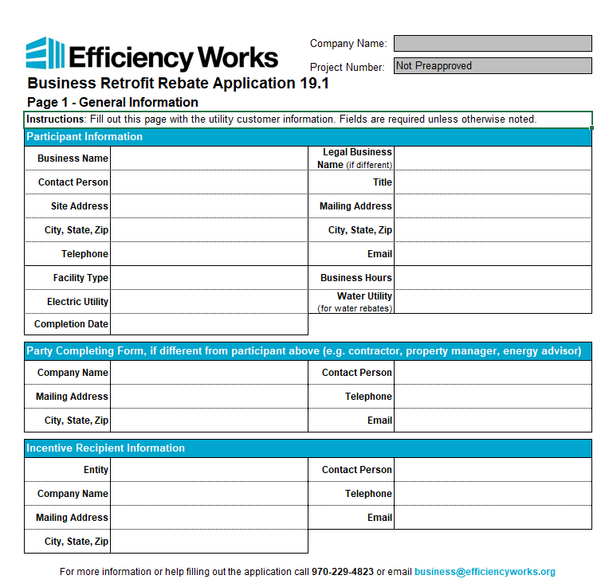
Application
Instructions
General project information
Notes:
Bryce

Slide 41
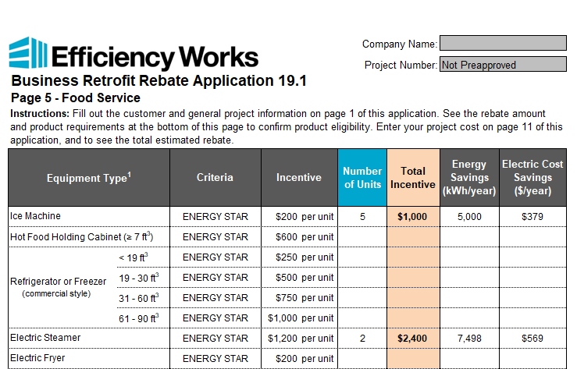
Application
Lighting has drop down menus
Enter quantities of new equipment on other pages
Notes:
Bryce

Slide 42
Application submissions
Email: Business@EfficiencyWorks.org
Pre-Approval
Project has not started
Required for incentives over $1,000
Rebate application
Project quote
For Payment
Project complete
Rebate application
Project invoice
Signed application
W9
Notes:
Bryce

Slide 43
Complete a project with Efficiency Works
1
2
3
4
5
Efficiency Works staff will review the final paperwork to verify energy savings and final incentive. Once all proper paperwork is received you will be notified that processing is complete and if there were any changes to the incentive.
After the upgrade is made send in the signed Request for Payment, final invoice(s), application, and W9 to business@efficiencyworks.org. Rebates can be paid to the contractor or customer.
Both the customer and contractor will receive a letter when final processing is complete. These letters summarize the project and the appropriate party's letter will include the incentive check. Receive letters in 4-6 weeks.
When the customer is ready to move forward with the project given your estimated rebate amount, it is time for pre-approval. Send the application and project quote in to Efficiency Works at info@efficiencyworks.co.
Efficiency Works staff reviews your application to make sure that it is inline with program rules. Energy advising or an inspection may be necessary before being granted an approval code.

Slide 44
Efficiency Works Business:
2019 and beyond
Notes:
Bryce

Slide 45
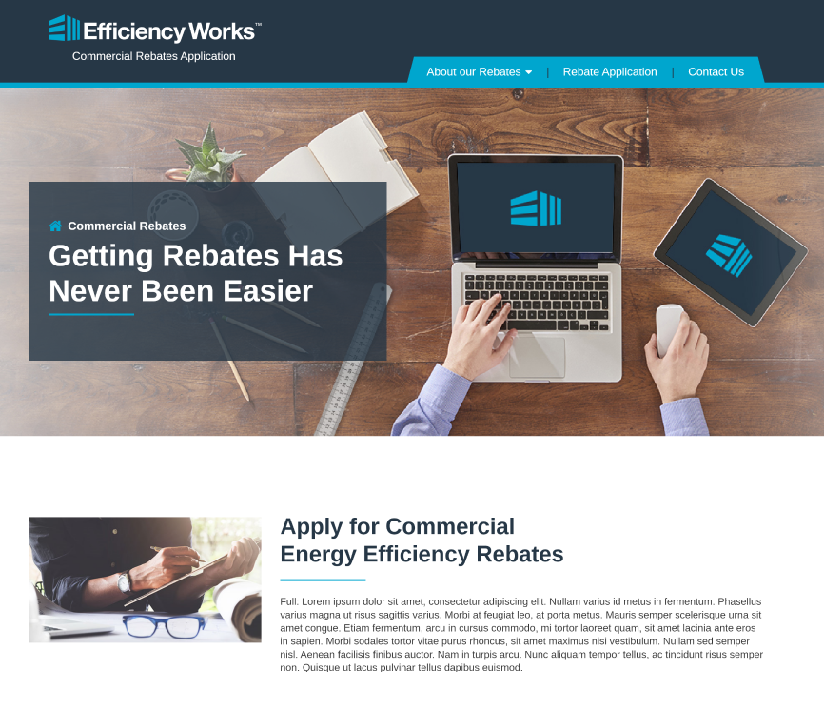
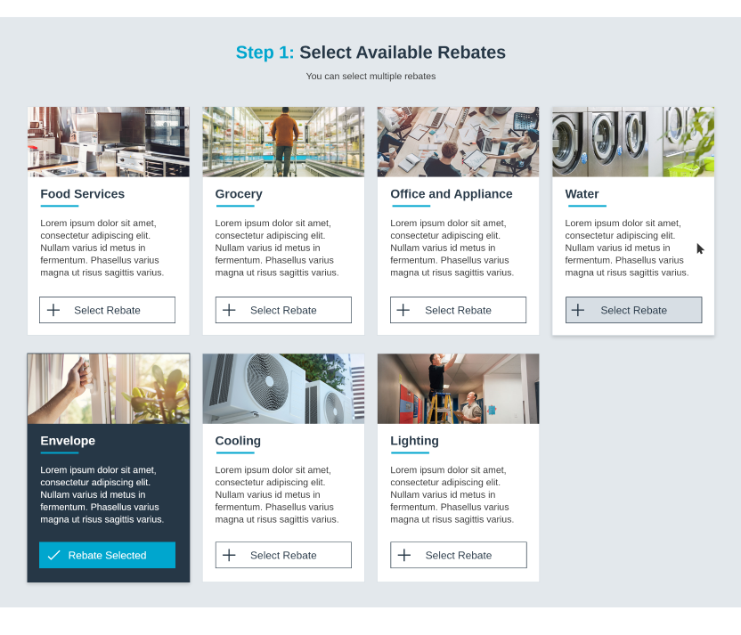
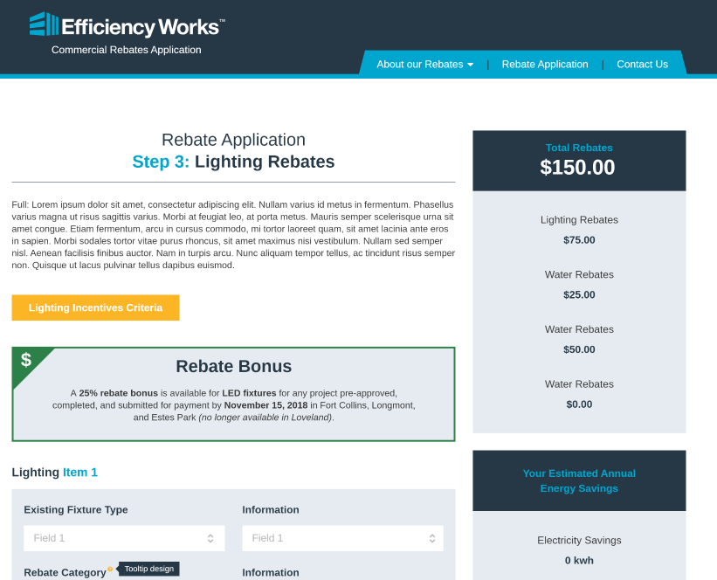
Coming in 2019
New rebate forms online
Notes:
Bryce

Slide 46
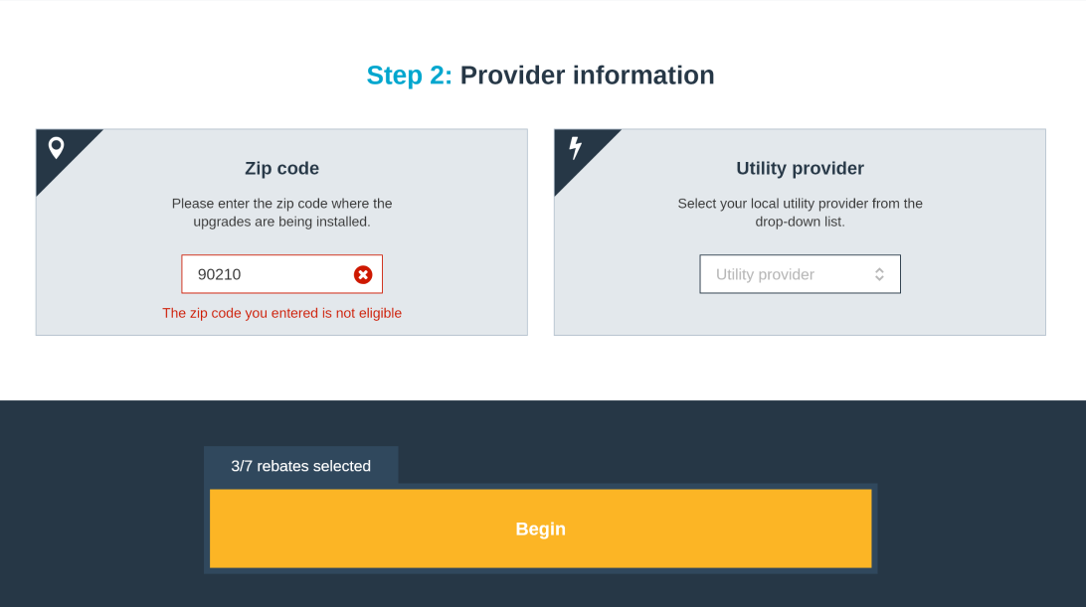
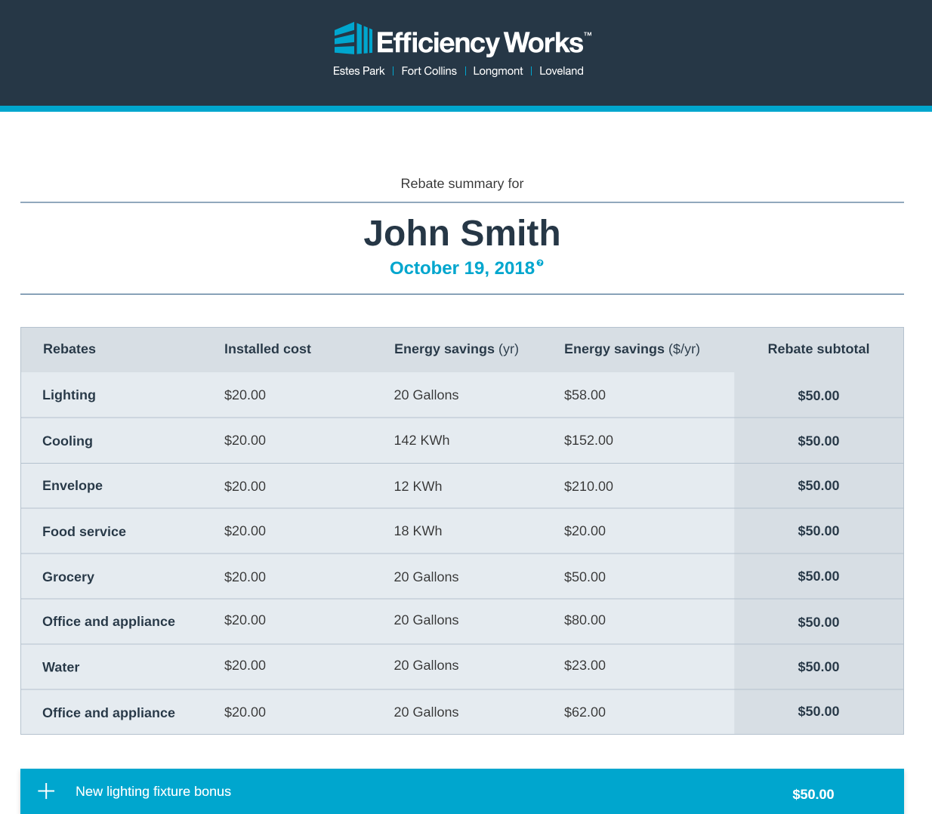
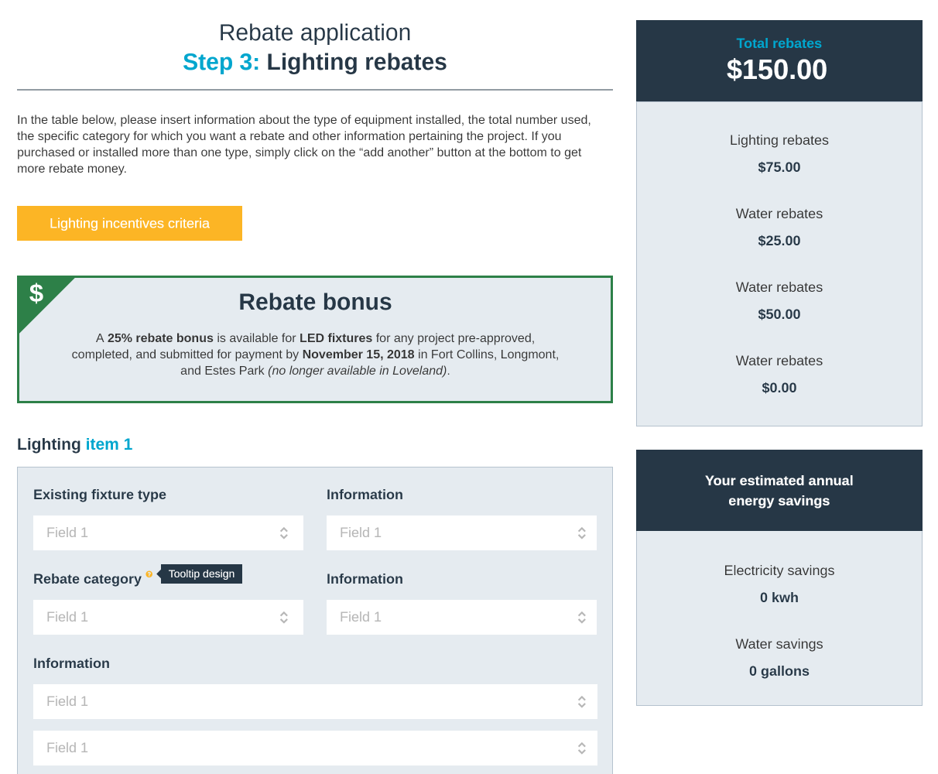
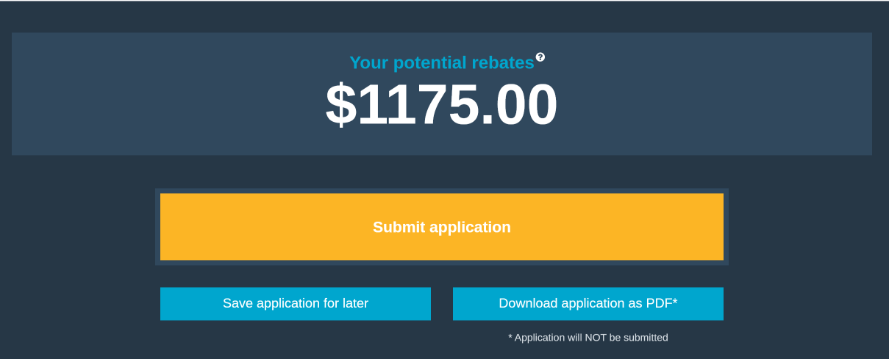
Online webforms
Notes:
Bryce

Slide 47
Coming in 2019
New programs:
Building Tune-Up tier 1 revamp
New Construction program
Expanding Multifamily program
Service provider tiers
Notes:
Bryce

Slide 48
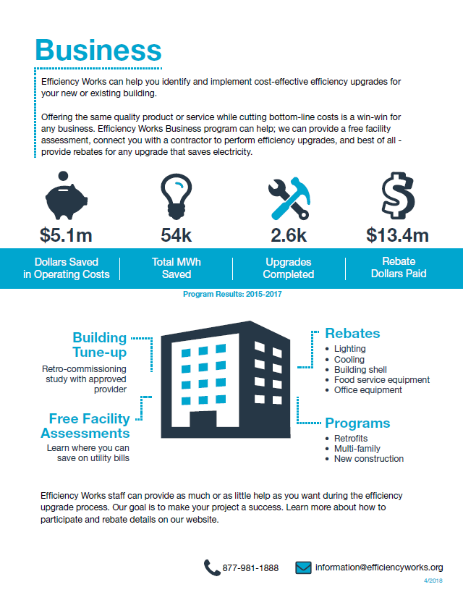
Service provider tiers
Benefits:
Listed as a premium contractor
Leads from energy advising
Premium rebate application
Access to marketing and branding materials
Marketing materials
Updated service provider portal
Notes:
Bryce

Slide 49
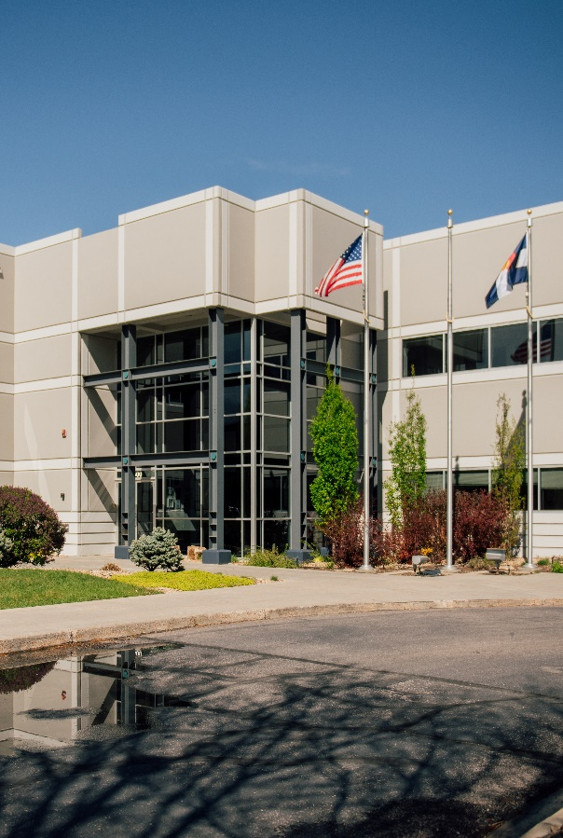
Future plans
New pilot programs to meet higher goals in 2019 and beyond, for example:
Direct installs and energy advising
New program models
Future collaboration with gas providers
Online access to efficiency equipment
Increase in marketing
Notes:
Bryce

Slide 50
Contact us Business@EfficiencyWorks.org 1-877-981-1888 Call direct at 970-229-4823
Notes:
Bryce

